Slide 1
Railway Reservation System
Team Member:-
Md Miraj Ansari
Vivek Pandey

Slide 2
Introduction
The railway reservation system facilitates the passengers to enquire about the trains available on the basis of source and destination, booking and cancellation of tickets, enquire about the status of the booked ticket, etc. Passengers can book their tickets for the train in which seats are available.

Slide 3
Modules
Admin
User
Booking
Payment

Slide 4
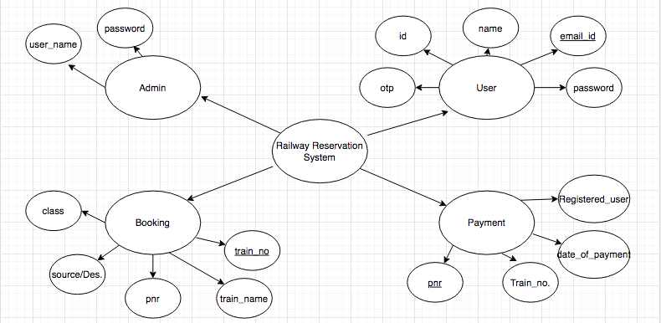
Design

Slide 5
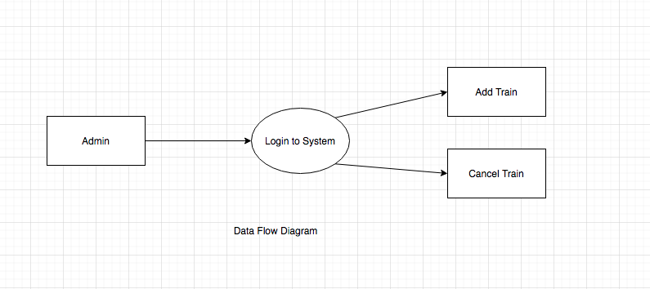
Data Flow Diagrams
Admin

Slide 6
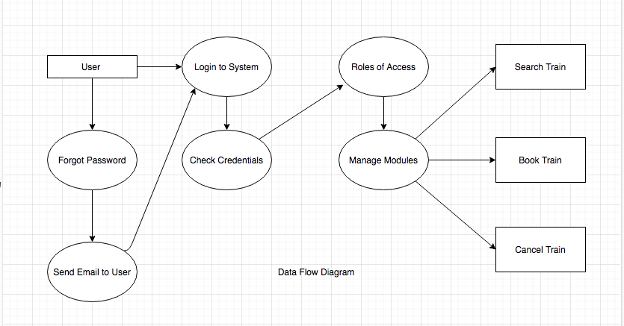
User

Slide 7
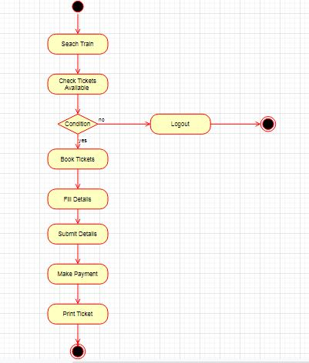
Activity Diagram

Slide 8
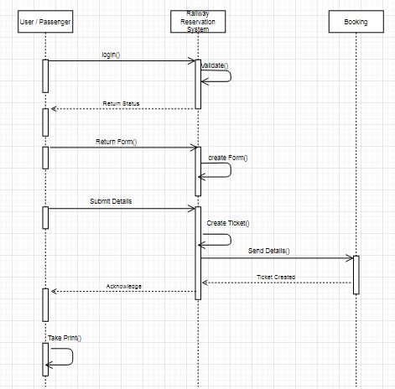
Sequence Diagram

Slide 9
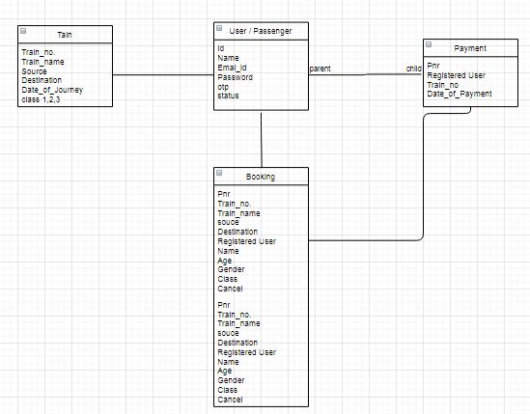
Uml Diagram

Slide 10
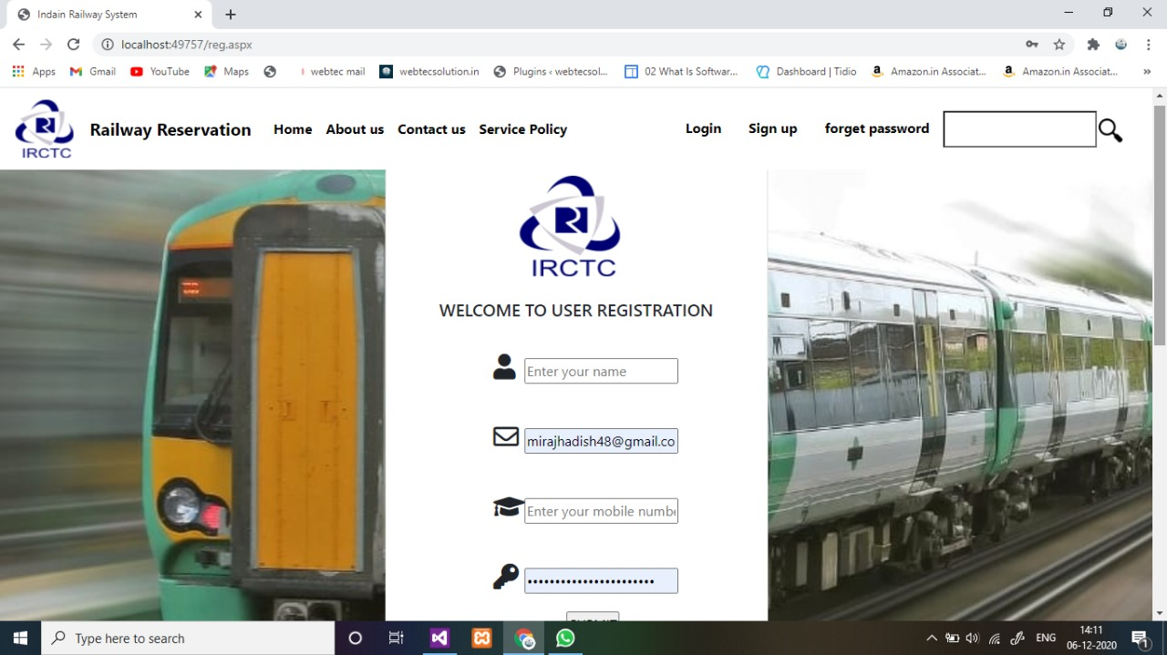
Screenshots

Slide 11
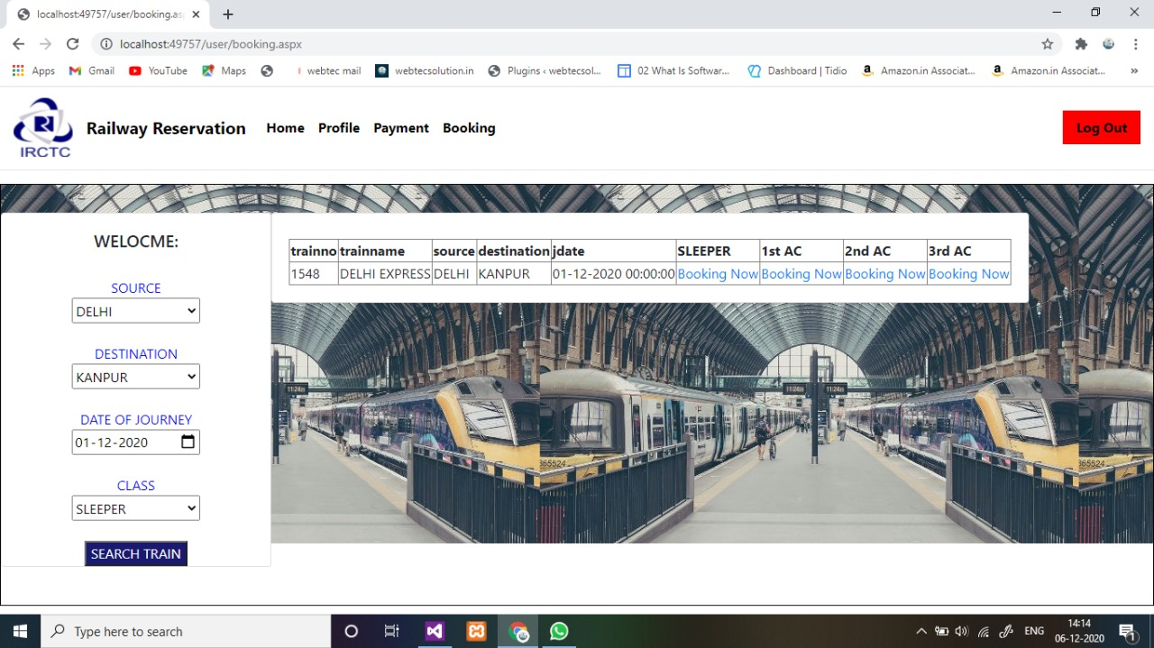

Slide 12
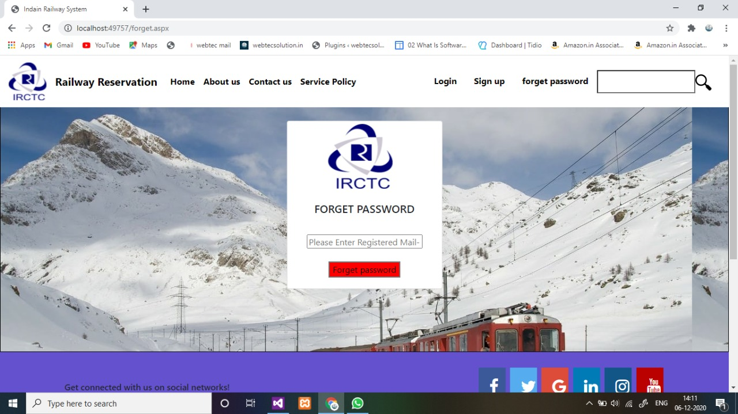

Slide 13
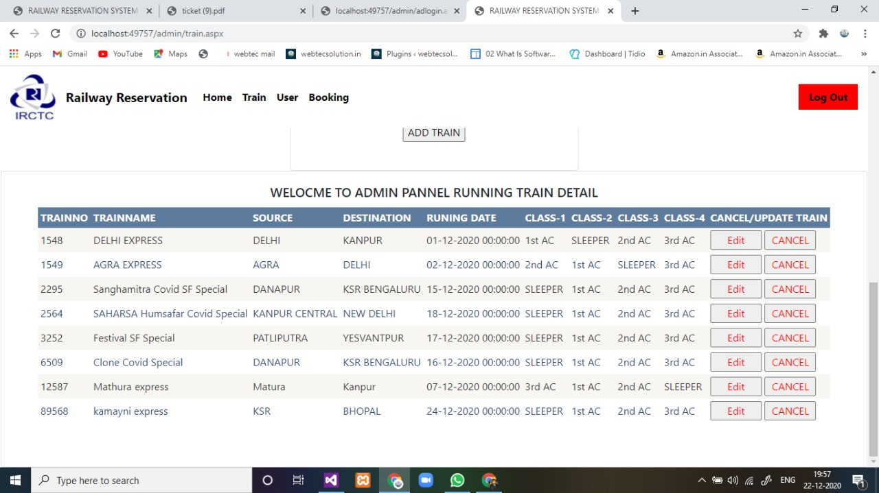

Slide 14
Future Scope
This project is currently running on the local server, as soon as we take the web API of the railway, we will make it live completely.
This project has been designed by looking at the current situation.We will use ADHAR data fetching techniques as soon as possible in the future, which is not being used in realtime in irctc.

Slide 15
Thank You.

